Slide 1
It’s a Grind
By: Ralph Recinto

Slide 2
background
Located in sf financial district
30 years
Large customers of office workers and wealthy fidi residents
Owned by Julian Cortez

Slide 3
problem
Newer coffee shops are starting up
Property prices are on the rise
steady drop in revenue
If the trend continues, paying rent would be a struggle

Slide 4
Possible solutions
Pros:
-Bonus rewards/savings
-More Space/nice atmosphere
-Higher revenue/better business
-Time efficient/ better service
Cons:
Irresponsible spending/interest rate
-Higher rent/Hard to maintain
-Lose customers/ less revenue
-Cold coffee / might not pick up
Upgraded Rewards card/app
Renovate coffee shop
Rent next door and extend the coffee shop
Raise prices
Partnership Uber eats
Order coffee ahead

Slide 5
Uber eats
delivers the best meals from favorite local restaurants in 10 minutes or less
Available M-F 11am-2pm
Fare split feature
How do you use it?
-Open the Uber app and select the meal icon at the top.
-Enter your location and tap VIEW MENU.
-Place order and your meal will be curbside in minutes.
Uber EATS is currently available in SoMa, FiDi, Nob Hill, Tenderloin, Hayes Valley and Mission Bay.

Slide 6
pros and cons
Renovation/features
UBER EATS
PROS:
-Cashless payment, same as an Uber ride
-Very convenient, particularly for the person whose meeting ran too long and is short on time before their next appointment
-You can track your delivery in real time
-Food is delivered within approximately 6-10 minutes
-Food delivery is currently only available in corporate business areas like Midtown and the Financial District
CONS:
-Although the coffee is ready, it loses a bit of its integrity
-They are able to rate you too
Pros:
-High End looks (Attraction)
-Target the “rich”
Cons:
-Construction (Days or weeks)
-Financing issues
-Adding features costing

Slide 7
Final solutions
Renovating and adding features at the coffee shop
Partnering up with UBER eats

Slide 8
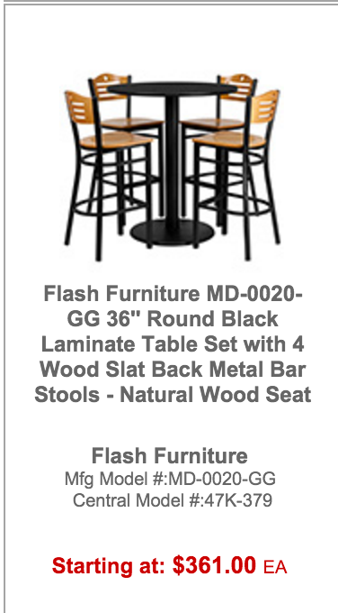
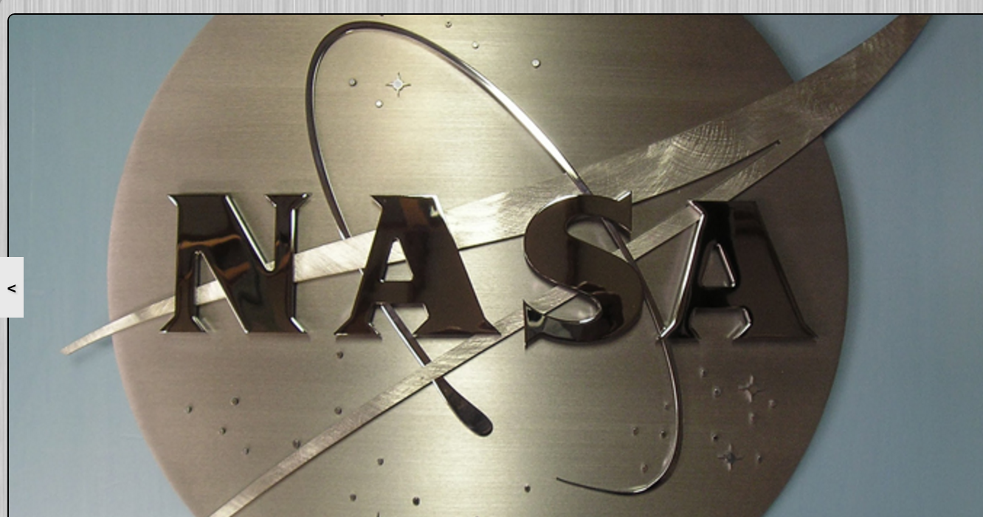
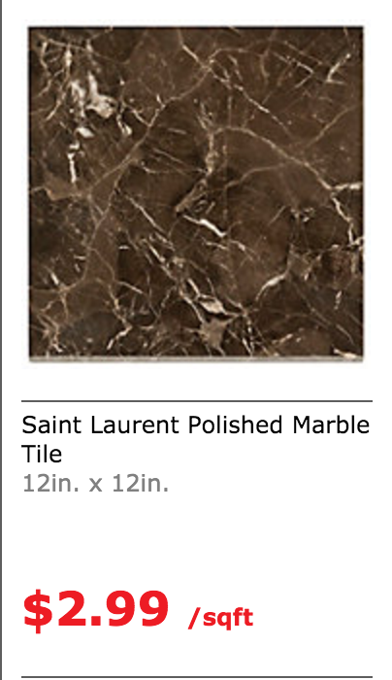
Action plan
Renovate coffee shop
7 sets
$2,571
$5,980
Positive-Cut Metal Logo (It’s A grind) Panel: $750

Slide 9
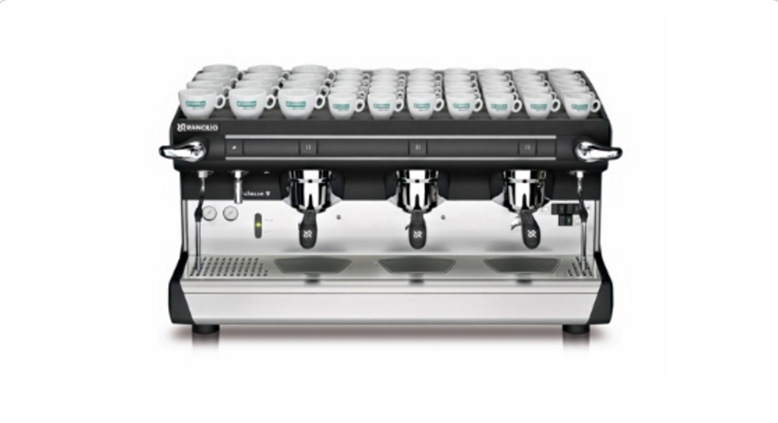
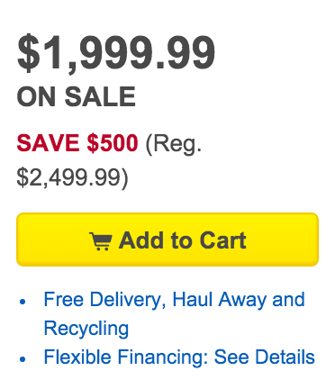
Rancilio CLASSE 9 S3 Classe 9 Manual Espresso Machine w/ 2-Steam Wand & 16-Liter Boiler
$10,000
150 Mbps
$49.99 per month
Samsung - 75" Class (74.5" Diag.) - LED - 1080p - Smart - HDTV - Black

Slide 10
Action Plan 2
Partner with uber eats
Set up meeting at SoMA Uber Hq
Double Advertising
Download App

Slide 11
Works cited
http://ubereats.com/eats/sf/restaurants/
http://ubereats.com/eats/sf/faq/
https://www.flooranddecor.com/marble-stone#prefn1=shape&srule=most-popular&sz=12&start=0&prefv1=Square
http://www.centralrestaurant.com/Indoor+Tables+and+Chairs-pl1295.html
http://www.xfinity.com/internet-service.html

